Slide 1

AduanePa Fie
University Food Delivery Marketplace
"Enjoy the Taste in Every Bite"

Slide 2

The Problem
No Centralized Discovery
Students lack a single platform to browse and order from campus-area food vendors.
No Reliable Tracking
No transparent order tracking or trustworthy delivery system exists for university communities.
Manual Vendor Operations
Vendors rely on phone calls to receive and manage orders — slow, error-prone, and unscalable.

Slide 3
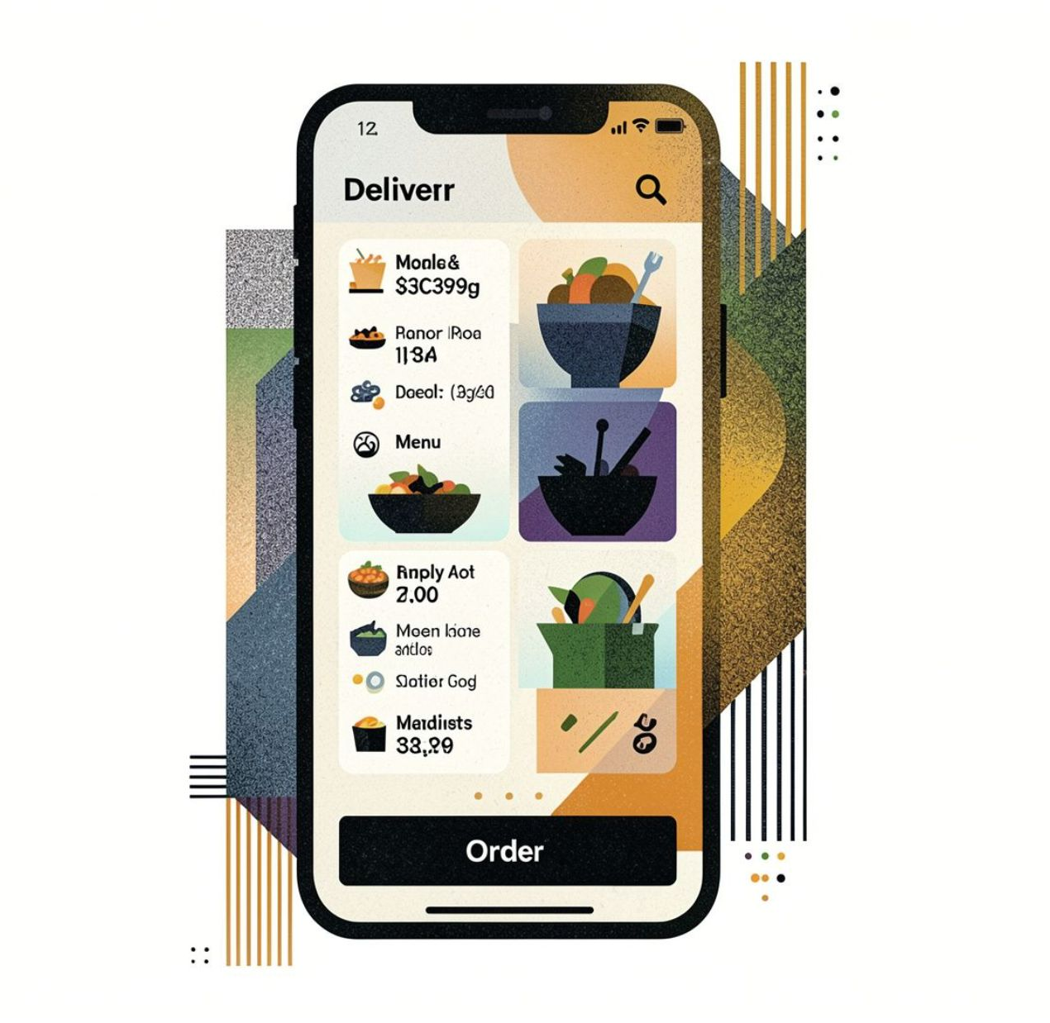
The Solution
1
Multi-Sided Marketplace
Connecting students, food vendors, and delivery riders in one unified platform.
2
Admin-Governed Ecosystem
An internal admin layer verifies accounts and maintains platform integrity.
3
Pay on Delivery
Simple, trust-building payment model at launch — no upfront digital payment required.
4
University-Based Discovery
Vendors are scoped to a student's university, not GPS proximity.

Slide 4
Platform Actors
Customer
Vendor
Student who browses vendors, places orders, and tracks delivery to their location.
Campus-area food business that lists menus, sets prices, and fulfills orders.
Rider
Admin
Independent courier who picks up orders from vendors and delivers to customers.
Internal team member who verifies accounts and manages platform operations.

Slide 5
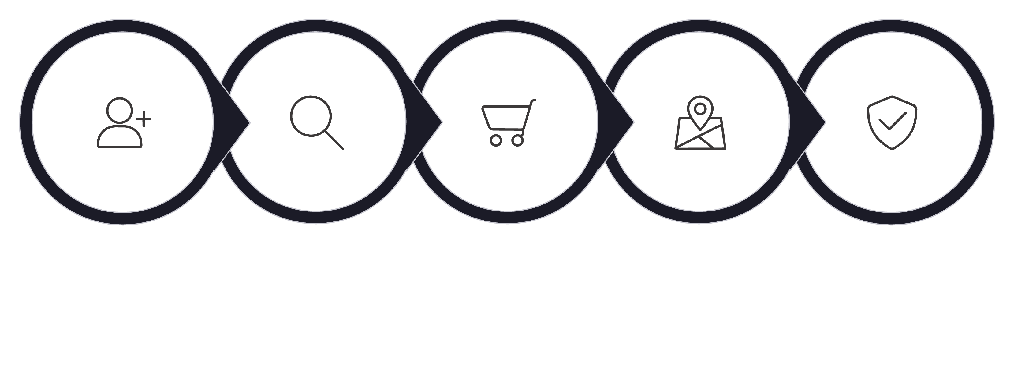
Customer Experience
Sign Up
Discover
Order
Track
Confirm
Every step is designed to be simple and trustworthy — from first signup to the moment food arrives at the door.

Slide 6

Vendor Portal
Menu Management
Create, edit, and delete products, categories, prices, and deals with ease.
Order Dashboard
Accept incoming orders and track each one through preparation stages.
Operating Hours
Set business hours and toggle store open/closed status in real time.
Business Profile
View verification status and account history at a glance.

Slide 7

Rider Experience
01
Sign Up
Submit name, email, phone, vehicle type, license, and vehicle documents for verification.
02
View Orders
See available orders in their city or region once approved.
03
Accept & Pick Up
Accept an order and receive full pickup and delivery details instantly.
04
Update Status
Track and update the order from pickup through to delivery.
05
Confirm Delivery
Collect the unique delivery code from the customer to officially close the order.

Slide 8

Admin Dashboard
The admin layer is the backbone of platform trust and operational health. Every vendor and rider is verified before going live, and every order can be monitored end-to-end.
Account Approval
User Management
Order Oversight
Analytics
Verify vendors and riders; manage supporting documents.
Search, filter, activate, or deactivate any account.
View all orders; filter by status, vendor, or university.
Track signups, active vendors, order volume, and completion rates.
Dispute Handling
Resolve undelivered orders and customer complaints.

Slide 9
Success Metrics
Activation Rate
Fulfillment Time
Vendor Onboarding Speed
5% of new users who complete their first order after signing up.
Average time from order placement to delivery at the customer's door.
How quickly vendors are approved and go live on the platform.
Completion Rate
Repeat Order Rate
Ratio of successfully delivered orders vs. cancelled orders.
30-day retention — how many users order again within a month.

